Slide 1
Enterprise Patterns
Lecturer: Ngo Huy Bien
Software Engineering Department
Faculty of Information Technology
VNUHCM - University of Science
Ho Chi Minh City, Vietnam
nhbien@fit.hcmus.edu.vn

Slide 2

Objectives
To present basic concepts of an enterprise system.
To design business logic of an enterprise system using Transaction Script, Table Module, Transfer Object, RecordSet, Business Object, Domain Model and Active Record, Simple Policy and Property Container pattern.
To design data access logic of an enterprise system using Data Access Object, Table Data Gateway, Row Data Gateway, Data Mapper, Registry and Unit of Work pattern.
To design presentation and controller logic of an enterprise system using Model View Controller, Page Controller, Front Controller, Template View, Transform View and Composite View pattern.

Slide 3

Contents

Slide 4

References
Gautam Shroff (2010). Enterprise Cloud Computing: Technology Architecture Applications. Cambridge University Press.
John Kanalakis (2003). Developing .NET Enterprise Applications. Apress.
Martin Fowler et al. (2002). Patterns Of Enterprise Application Architecture.
Deepak Alur et al. (2003). Core J2EE Patterns Best Practices And Design Strategies.
James Carey et al. (2000). SanFrancisco(TM) Design Patterns: Blueprints for Business Software. Addison-Wesley Professional.

Slide 5
Anatomy of an Corporation [1]
What does a manufacturing corporation do?
It plans what products to build, when, and in what quantities.
It then executes sales and marketing of its products
It coordinates manufacturing across plants and suppliers.
It distributes the product to customers.
It supports them after they have bought the product.
Enterprise applications need to keep track of information related to operations of the enterprise.
The core processes that take place in the enterprise are then managed by creating and manipulating this information.

Slide 6
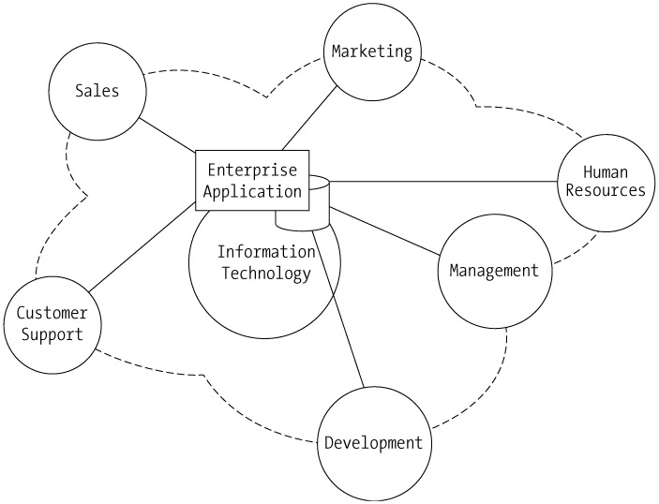
Enterprise Application [2]
An enterprise represents a corporate entity with several interacting departments, each managing different types of data and performing different functions.
For an enterprise application to support different departments, it needs to manage two important company assets: business data and business processes.

Slide 7
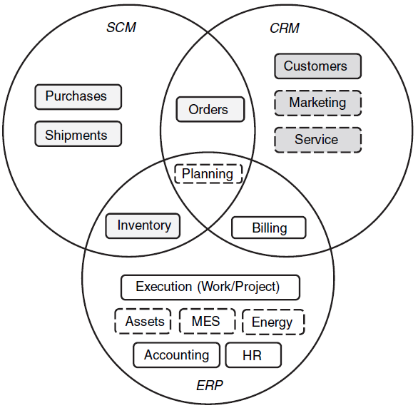
Core Enterprise Data [1]
CRM – customer relationship management
SCM – supply chain management
ERP – enterprise resource planning
MES – manufacturing execution systems

Slide 8
Business Data
Business data is any data that helps a business operate more effectively.
Business data needs to be reliably accessible, scalable, and secure.
Accessibility – Multiple users operating on a variety of platforms and devices interact with the business data.
Scalability – Increases the number of system resources.
Secure - Offers data access to specific users.

Slide 9
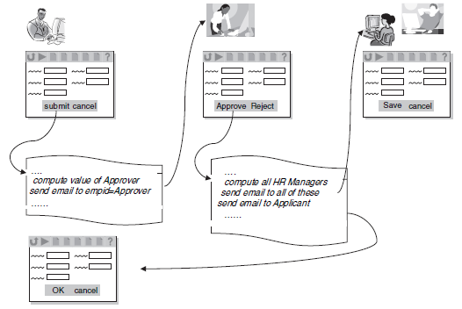
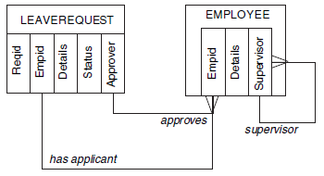
Business Process
A business process, or workflow, is a series of steps that accomplishes a specific business goal.
Business process automation solutions implement processes that combine automated and human interaction tasks and that provide a user interface for graphical modeling.

Slide 10
Enterprise Development Process [2]
Capturing the Requirements
Prototyping the Application
Designing the Application
Developing the Application
Testing the Application
Deploying the Application

Slide 11


Slide 12
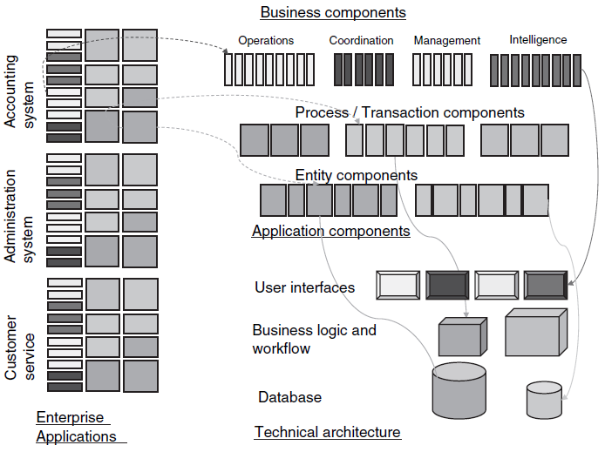
Component View of Enterprise Architecture [1]

Slide 13
Enterprise Components
The coarsest level of enterprise components are business components, defined as collections of high-level enterprise processes.
At the next level of granularity, high-level enterprise processes are broken down into sequences of smaller processes, and also regrouped so as to be implemented in a set of applications.
This process results in application components: Each application component is a set of smaller processes such that the information needs of this set is largely restricted to a cohesive set of data.
When implemented in software systems, application components are themselves decomposed into software components.
These software components can be “entity components,” that deal with the manipulation of enterprise data, and
“process components” that deal with the business logic and workflow needs of the application component.

Slide 14
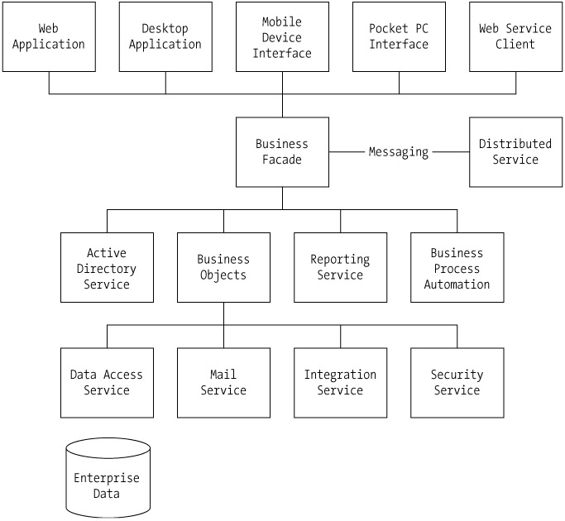
Enterprise Application Components [2]

Slide 15
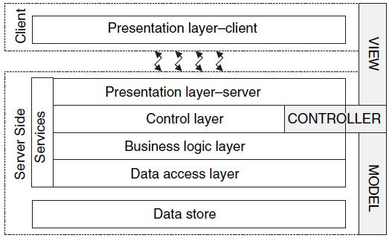
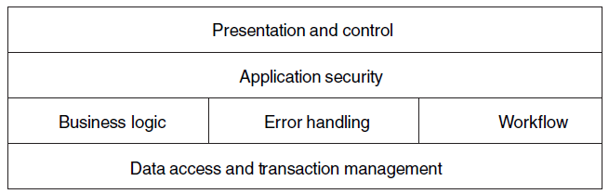
Software Architecture for Enterprise Components [1]

Slide 17

Hotel Booking
Input:
Passport number, from date, to date
40 available rooms (in table Rooms)
Output (being saved to Booking table):
Passport number
Room number
From date, to date
Price
Business Rules:
Invalid passport number: “12XX” (Iran), “34YY” (North Korean)
Stay period < 5 days: $100 per day
Stay period >= 5 days: $70 per day
Returned customer (based on passport number): discount 50%

Slide 18

Transaction Script [3]
Each interaction between a client system and a server system contains a certain amount of logic.
In some cases this can be as simple as displaying information in the database.
In others it may involve many steps of validations and calculations.
☠ Problem: How do we design this domain logic?
☞ Solution: A Transaction Script organizes all this logic primarily as a single procedure, making calls directly to the database or through a thin database wrapper.
Each transaction will have its own Transaction Script, although common subtasks can be broken into sub-procedures.

Slide 19
Transaction Script Example
Create table Booking (passport number, room number, from date, to date, price)
Create Booking class
Create Book(passportNumber, fromDate, toDate) method.
Check passport number rule.
Get available room from the table Rooms (using ReservedUntil field).
Get returned customer from the table Booking (using PassportNumber field).
Calculate price.
Insert information (passport number, room number, from date, to date, price) into the table Booking.
Update ReservedUntil field of the table Rooms.

Slide 20

How to Use Transaction Script?
Transaction Script organizes business logic by procedures where each procedure handles a single request from the presentation.
Start from a use case and work back.
The majority of the business logic resides in the service classes.
The domain objects are lightweight mere data place holders.

Slide 21

Transaction Script Pros and Cons
The glory of Transaction Script is its simplicity.
Since the whole point is to handle one transaction, any common code tends to be duplicated.

Slide 22
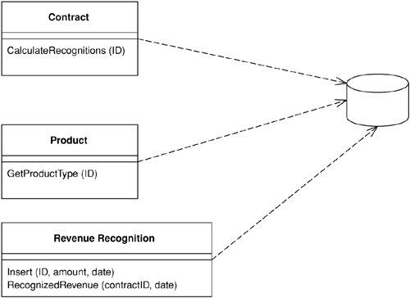
Table Module
☠ Problem: How do we design domain logic working with relational databases?
☞ Solution: A Table Module organizes domain logic with one class per table in the database, and a single instance of a class contains the various procedures that will act on the data.

Slide 23
Table Module Example
Create table Booking (passport number, room number, from date, to date, price)
Create BookingModule class
Create Book(passportNumber, roomNumber, fromDate, toDate, price) method.
Check passport number rule.
Create RoomModule class and use it to get available room from the table Rooms (using ReservedUntil field).
Get returned customer from the table Booking (using PassportNumber field).
Calculate price.
Insert information (passport number, room number, from date, to date, price) into the table Booking.
Update ReservedUntil field of the table Rooms.

Slide 24
Table Module Pros and Cons
Table Module is very much based on table-oriented data, so obviously using it makes sense when you're accessing tabular data.
You can't have direct instance-to-instance relationships, and polymorphism doesn't work well.

Slide 25
☠ Transfer Object: Problem [3, 4]
You want to transfer multiple data elements over a tier.
You want clients to access components in other tiers to retrieve and update data.
You want to reduce remote requests across the network.
You want to avoid network performance degradation caused by chattier applications that have high network traffic.
You need to reduce the number of calls, and that means that you need to transfer more data with each call.
One way to do this is to use lots of parameters.
However, this is often awkward to program.

Slide 26
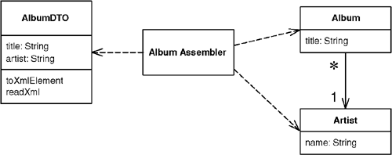
☞ Transfer Object: Solution
Use a Transfer Object to carry multiple data elements across a tier.
The Transfer Object is a serializable plain object that contains several members to aggregate and carry all the data in a single method call.
Instead of sending or receiving individual data elements, a Transfer Object contains all the data elements in a single structure required by the request or response.
A Transfer Object is designed to optimize data transfer across tiers.

Slide 27
Transfer Object Example
Create table Booking (passport number, room number, from date, to date, price)
Create BookingModule class
Create BookingDTO class with the following properties: PassportNumber, FromDate, ToDate, RoomNumber, Price.
Create BookingDTO Book(BookingDTO input) method.
Check passport number rule.
Create RoomModule class and use it to get available room from the table Rooms (using ReservedUntil field).
Get returned customer from the table Booking (using PassportNumber field).
Calculate price.
Insert information (passport number, room number, from date, to date, price) into the table Booking.
Update ReservedUntil field of the table Rooms.
Return a BookingDTO instance containing reserved room number and price.

Slide 28
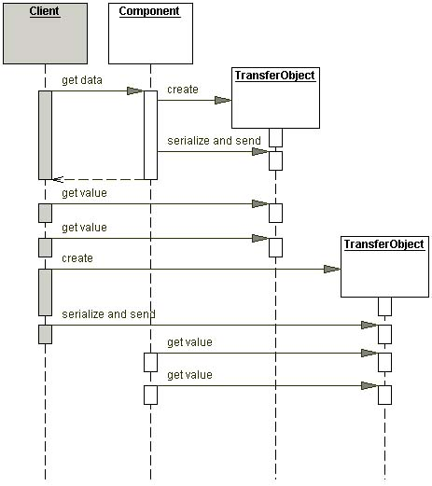
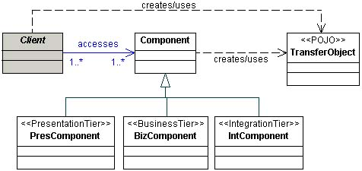
Transfer Object: Structure

Slide 29
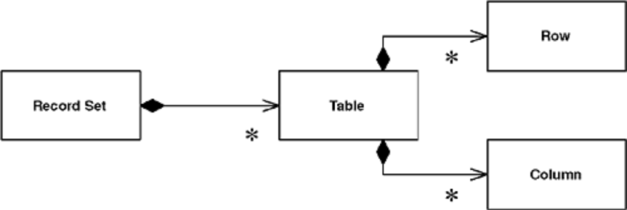
Record Set [3]
☠ Problem: How a relational database returns a result to your application?
☞ Solution: A Record Set is an in-memory representation of tabular data.
A Record Set is usually something that you won't build yourself, provided by the vendor of the software platform you're working with. Examples include the data set of ADO.NET and the row set of JDBC 2.0.
A Record Set is just a specific Data Transfer Object.

Slide 31


Complicated Domain Logic Example
Transferring money from one checking account to another
Inputs:
The identity of the person making the transfer
The amount of money to be transferred
The source checking account number
The target checking account number
Business rules
The person making the request must have the authority to do so.
The source checking account must have enough money.
The target checking account must be in a status of being able to receive money.
The transaction must be atomic.
The transaction may have reporting requirements to the government, if it is over a certain amount.
Notifications should be sent to all related people.
The transaction must be available for audit.

Slide 32
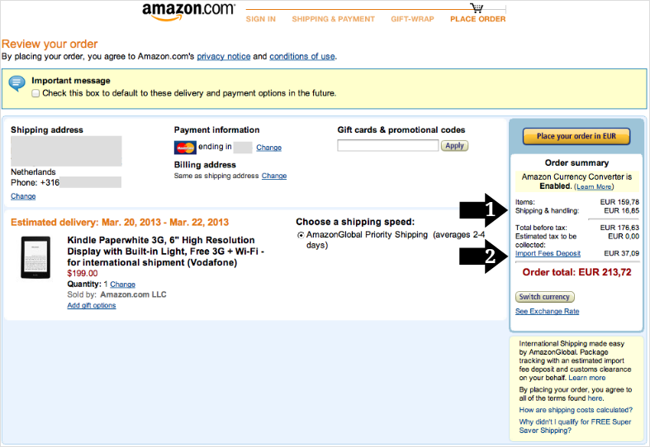
Amazon Order Example

Slide 33
☠ Business Object: Problem [3, 4]
How do we design complicated domain logic?
You have a conceptual model with sophisticated validation, business logic (calculations, processes), and business rules (constraints).
You want to group a set of business-related objects to avoid dealing with internal complex structure.
You want to separate the business state and related behavior from the rest of the application, improving cohesion and reusability.
You want to centralize business logic and state in an application.
You want to increase reusability of business logic and avoid duplication of code.

Slide 34
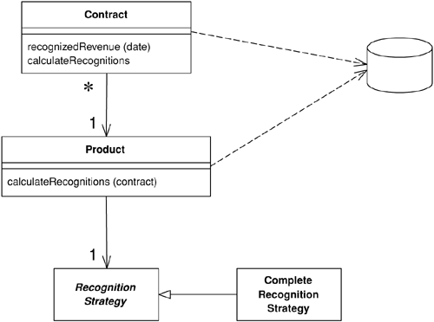
☞ Business Object: Solution
A Business Object is an object that implements a well-defined business domain concept and includes intrinsic business logic and business rules that apply to that domain concept.
A Business Object encapsulate and manage business data, behavior and persistence.

Slide 35
Business Object Example
Create table Booking (passport number, room number, from date, to date, price)
Create Customer class with PassportNumber property and use it to check passport number rule and get returned customer.
Create Room class with RoomNumber and ReservedUntil property and use it to get available room.
Create BookingPrice class with StartDate, EndDate and Customer properties and GetPrice method
Create BookingDTO class with the following properties: PassportNumber, FromDate, ToDate, RoomNumber, Price.
Create Booking class with Customer, Room and BookingPrice properties.
Create BookingDTO Book(BookingDTO input) method.
Create Customer, Room and BookingPrice instance and call appropriate methods.
Insert information (passport number, room number, from date, to date, price) into the table Booking (Booking’s responsibility).
Update ReservedUntil field of the table Rooms (Room’s responsibility).

Slide 36
Customer or Price Rule Change
Create table Booking (passport number, room number, from date, to date, price)
Create Customer class with PassportNumber property and use it to check passport number rule and get returned customer.
Create Room class with RoomNumber and ReservedUntil property and use it to get available room.
Create BookingPrice class with StartDate, EndDate and Customer properties and GetPrice method
Create BookingDTO class with the following properties: PassportNumber, FromDate, ToDate, RoomNumber, Price.
Create Booking class with Customer, Room and BookingPrice properties.
Create BookingDTO Book(BookingDTO input) method.
Create Customer, Room and BookingPrice instance and call appropriate methods.
Insert information (passport number, room number, from date, to date, price) into the table Booking (Booking’s responsibility).
Update ReservedUntil field of the table Rooms (Room’s responsibility).

Slide 37

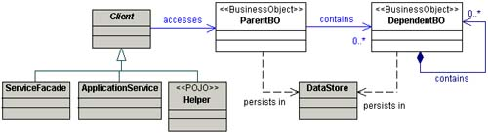
Business Object: Structure

Slide 38
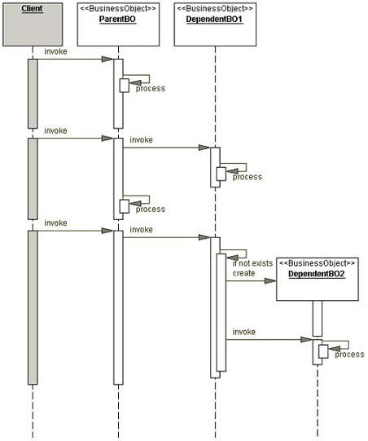
Business Object: Dynamic

Slide 39
Domain Model
A Domain Model creates a web of interconnected objects, where each object represents some meaningful individual, whether as large as a corporation or as small as a single line on an order form.
A simple Domain Model looks very much like the database design with mostly one domain object for each database table.
A rich Domain Model can look different from the database design, with inheritance, strategies, and other patterns, and complex webs of small interconnected objects.

Slide 40
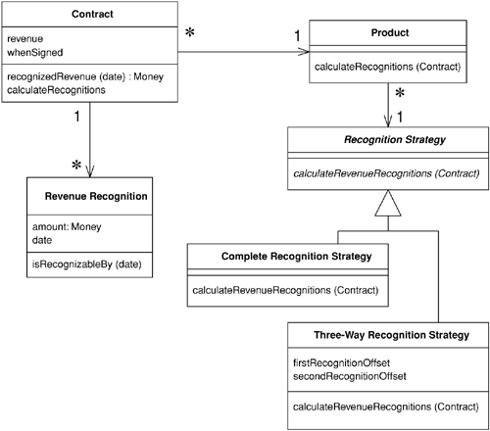
Another Domain Model Example
List revenueRecognitions
One of the biggest frustrations of describing a Domain Model is the fact that any example I show is necessarily simple so you can understand it; yet that simplicity hides the Domain Model's strength. You only appreciate these strengths when you have a really complicated domain.
Requirement: Calculating how much revenue is recognized on a particular date.

Slide 41
Revenue Recognition
class RevenueRecognition...
private Money amount;
private MfDate date;
public RevenueRecognition(Money amount, MfDate date) {
this.amount = amount;
this.date = date;
}
public Money getAmount() {
return amount;
}
boolean isRecognizableBy(MfDate asOf) {
return asOf.after(date) || asOf.equals(date);
}

Slide 42
Contract: recognizedRevenue
class Contract...
private List revenueRecognitions = new ArrayList();
public Money recognizedRevenue(MfDate asOf) {
Money result = Money.dollars(0);
Iterator it = revenueRecognitions.iterator();
while (it.hasNext()) {
RevenueRecognition r =
(RevenueRecognition) it.next();
if (r.isRecognizableBy(asOf))
result = result.add(r.getAmount());
}
return result;
}

Slide 43
Revenue Recognitions Source
Contract(Product product, Money revenue, MfDate whenSigned)
The calculation and creation begin with the customer and are handed off via the product to a strategy hierarchy.

Slide 44
Each Contract Has A Product
class Contract...
private Product product;
private Money revenue;
private MfDate whenSigned;
private Long id;
public Contract(Product product, Money revenue, MfDate whenSigned) {
this.product = product;
this.revenue = revenue;
this.whenSigned = whenSigned;
}
class Product...
private String name;
private RecognitionStrategy recognitionStrategy;
public Product(String name, RecognitionStrategy recognitionStrategy) {
this.name = name;
this.recognitionStrategy = recognitionStrategy;
}
class RecognitionStrategy...
abstract void calculateRevenueRecognitions(Contract contract);
Each Product Has Its Own Recognition Way

Slide 45
Recognition Strategies
class CompleteRecognitionStrategy...
void calculateRevenueRecognitions(Contract contract) {
contract.addRevenueRecognition(new RevenueRecognition(contract.getRevenue(),
contract.getWhenSigned()));
}
class ThreeWayRecognitionStrategy...
private int firstRecognitionOffset;
private int secondRecognitionOffset;
public ThreeWayRecognitionStrategy(int firstRecognitionOffset,
int secondRecognitionOffset)
{
this.firstRecognitionOffset = firstRecognitionOffset;
this.secondRecognitionOffset = secondRecognitionOffset;
}
void calculateRevenueRecognitions(Contract contract) {
Money[] allocation = contract.getRevenue().allocate(3);
contract.addRevenueRecognition(new RevenueRecognition
(allocation[0], contract.getWhenSigned()));
contract.addRevenueRecognition(new RevenueRecognition
(allocation[1], contract.getWhenSigned().addDays(firstRecognitionOffset)));
contract.addRevenueRecognition(new RevenueRecognition
(allocation[2], contract.getWhenSigned().addDays(secondRecognitionOffset)));
}

Slide 46
Calculating the Recognitions
class Contract...
private Product product;
private Money revenue;
private MfDate whenSigned;
public Contract(Product product, Money revenue, MfDate whenSigned) {
this.product = product;
this.revenue = revenue;
this.whenSigned = whenSigned;
}
public void calculateRecognitions() {
product.calculateRevenueRecognitions(this);
}
class Product...
private String name;
private RecognitionStrategy recognitionStrategy;
public Product(String name, RecognitionStrategy recognitionStrategy) {
this.name = name;
this.recognitionStrategy = recognitionStrategy;
}
public void calculateRevenueRecognitions(Contract contract) {
recognitionStrategy.calculateRevenueRecognitions(contract);
}

Slide 47
Domain Model Pros and Cons
If you have complicated and ever-changing business rules involving validation, calculations, and derivations, chances are that you'll want an object model to handle them (Why? – Separation of concerns).
A rich Domain Model is better for more complex logic, but is harder to map to the database.

Slide 48
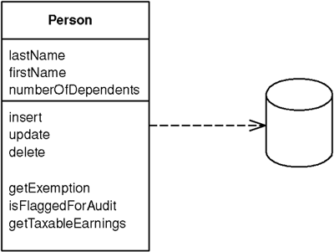
Active Record [3]
☠ Problem: How do we design business objects (domain model)?
☞ Solution: Active Record is an object that wraps a row in a database table or view, encapsulates the database access, and adds domain logic on that data.
The Active Record class typically has methods that do the following:
Construct an instance of the Active Record from a SQL result set row
Construct a new instance for later insertion into the table
Static finder methods to wrap commonly used SQL queries and return Active Record objects
Update the database and insert into it the data in the Active Record
Get and set the fields
Implement some pieces of business logic

Slide 49
Active Record Example
Create table Booking (passport number, room number, from date, to date, price)
Create BookingRecord class
Create properties: PassportNumber, FromDate, ToDate, RoomNumber, Price.
Create Book () method.
Check passport number rule.
Get returned customer from the table Booking (using PassportNumber field).
Calculate price.
Create RoomRecord class with RoomNumber, ReservedUntil properties and use it to get available room from table Rooms.
Insert information (passport number, room number, from date, to date, price) into the table Booking.
Update ReservedUntil field of the table Rooms.

Slide 50
Customer or Price Rule Change
Create table Booking (passport number, room number, from date, to date, price)
Create BookingRecord class
Create properties: PassportNumber, FromDate, ToDate, RoomNumber, Price.
Create Book () method.
Check passport number rule.
Get returned customer from the table Booking (using PassportNumber field).
Calculate price.
Create RoomRecord class with RoomNumber, ReservedUntil properties and use it to get available room from table Rooms.
Insert information (passport number, room number, from date, to date, price) into the table Booking.
Update ReservedUntil field of the table Rooms.

Slide 51
Active Record Pros and Cons
Active Record is a good choice for domain logic that isn't too complex, such as creates, reads, updates, and deletes.
If your business logic is complex, you'll soon want to use your object's direct relationships, collections, inheritance, and so forth.
➾ These don't map easily onto Active Record, and adding them piecemeal gets very messy.
Another argument against Active Record is the fact that it couples the object design to the database design.
➾ This makes it more difficult to refactor either design as a project goes forward.

Slide 52
Active Record Notes
RoomRecord availableRoom = RoomRecord.GetOneAvailableRoom();
Avoid using static classes to implement your domain objects. Why?
Avoid using static methods to implement your transaction methods. Why?
If you use procedural code then have your procedural code avoid global state. Why?
We can easily refactor Active Records to a Domain Model.

Slide 53
Layer Super-Type
☠ Problem: You have methods or attributes that are duplicated throughout a layer.
☞ Solution: Move all of this behavior into a common Layer Super-type.
All you need is a super-class for all the objects in a layer—for example, a Domain Object super-class for all the domain objects in a Domain Model.
class DomainObject...
private Long ID;
public Long getID() { return ID; }
public void setID(Long ID) {
Assert.notNull("Cannot set a null ID", ID);
this.ID = ID;
}
public DomainObject(Long ID) { this.ID = ID; }
public DomainObject() { }

Slide 55
☠ Data Access Object: Problem [3, 4]
You want to decouple the persistent storage implementation from the rest of your application. Why? – Maintenance.
You want to organize data access logic and encapsulate proprietary features to facilitate maintainability and portability.
You want to provide a uniform data access API for a persistent mechanism to various types of data sources, such as RDBMS, LDAP, OODB, XML repositories, flat files, and so on.
Mixing SQL in application logic can cause several problems.
Many developers aren't comfortable with SQL, and many who are comfortable may not write it well.
Database administrators need to be able to find SQL easily so they can figure out how to tune and evolve the database.

Slide 56
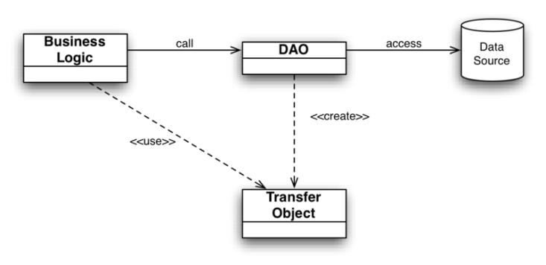
☞ Data Access Object: Solution
The Data Access Object (DAO) is an object that implements the access mechanism required to work with the data source.
The DAO manages the connection with the data source to obtain and store data.
The DAO always provides a uniform API to its clients.
The DAO abstracts the underlying data access implementation for the Client to enable transparent access to the data source.

Slide 57
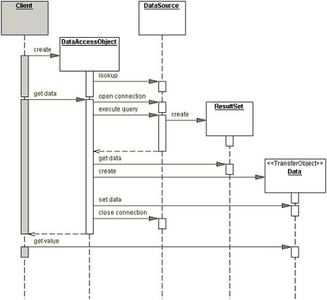
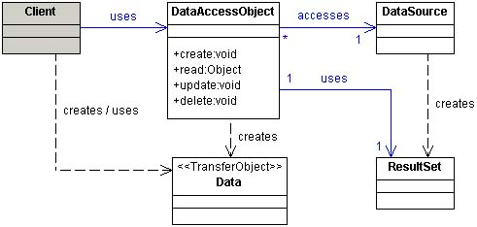

Data Access Object: Structure

Slide 58
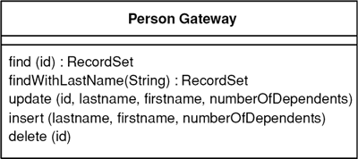
Table Data Gateway [3]
☠ Problem: How do we design data access objects working with relational databases.
☞ Solution: A Table Data Gateway holds all the SQL for accessing a single table or view: selects, inserts, updates, and deletes.
Other code calls its methods for all interaction with the database.
A Table
No object representing a row

Slide 59
Table Module + TDG Example
Create table Booking (passport number, room number, from date, to date, price)
Create BookingModule class
Create Book(passportNumber, roomNumber, fromDate, toDate, price) method.
Check passport number rule.
Create RoomModule class and use it to get available room from the table Rooms (using ReservedUntil field).
Get returned customer from the table Booking (using PassportNumber field).
Calculate price.
Insert information (passport number, room number, from date, to date, price) into the table Booking.
Update ReservedUntil field of the table Rooms.
BookingTableGateway
(no fields)
RoomTableGateway
(no fields)

Slide 60
Business Object + TDG Example
RoomTableGateway
Create table Booking (passport number, room number, from date, to date, price)
Create Customer class with PassportNumber property and use it to check passport number rule and get returned customer.
Create Room class with RoomNumber and ReservedUntil property and use it to get available room.
Create BookingPrice class with StartDate, EndDate and Customer properties and GetPrice method
Create BookingDTO class with the following properties: PassportNumber, FromDate, ToDate, RoomNumber, Price.
Create Booking class with Customer, Room and BookingPrice properties.
Create BookingDTO Book(BookingDTO input) method.
Create Customer, Room and BookingPrice instance and call appropriate methods.
Insert information (passport number, room number, from date, to date, price) into the table Booking (the Booking’s responsibility).
Update ReservedUntil field of the table Rooms (the Room’s responsibility).
BookingTableGateway

Slide 61

Questions
Can a Table Module act as a Table Data Gateway?
Can a Business Object act as a Table Data Gateway?

Slide 62
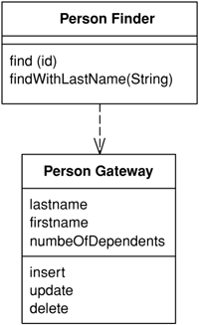
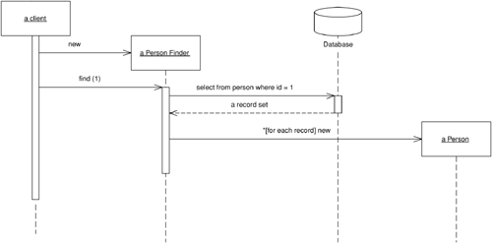
Row Data Gateway
☠ Problem: How do we design data access objects working with relational databases.
☞ Solution: A Row Data Gateway gives you objects that look exactly like the record in your record structure but can be accessed with the regular mechanisms of your programming language.
All details of data source access are hidden behind this interface.
A Row
Object representing a row

Slide 63
Row Data Gateway Example
Create table Booking (passport number, room number, from date, to date, price)
Create BookingModule class
Create Book(passportNumber, roomNumber, fromDate, toDate, price) method.
Check passport number rule.
Create RoomModule class and use it to get available room from the table Rooms (using ReservedUntil field).
Get returned customer from the table Booking (using PassportNumber field).
Calculate price.
Insert information (passport number, room number, from date, to date, price) into the table Booking.
Update ReservedUntil field of the table Rooms.
BookingRowGateway (with fields)
{PassportNumber, RoomNumber, …}
RoomRowGateway with fields
{RoomNumber, ReservedUntil}

Slide 64
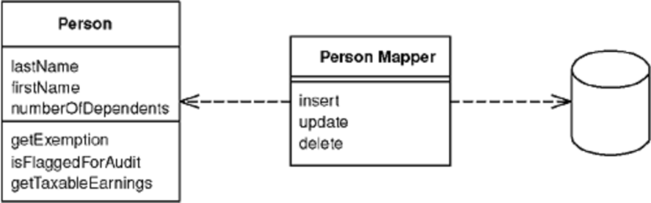
Data Mapper
☠ Problem: You want the database schema and the object model to evolve independently. Why? – Separation of concerns.
But why separation of concerns – Maintenance.
☞ Solution: The Data Mapper is a layer of software that separates the in-memory objects from the database.
Its responsibility is to transfer data between the two and also to isolate them from each other.
With Data Mapper the in-memory objects needn't know even that there's a database present; they need no SQL interface code, and certainly no knowledge of the database schema.
Client
An Aggregate

Slide 65
Data Mapper Example
BookingTableGateway
RoomTableGateway
Create table Booking (passport number, room number, from date, to date, price)
Create Customer class with PassportNumber and IsOldCustomer property and use it to check passport number rule.
Create Room class with RoomNumber and ReservedUntil property.
Create BookingPrice class with StartDate, EndDate and Customer properties and GetPrice method.
Create Booking class with Customer, Room and BookingPrice properties.
Create BookingMapper class with Booking Book(Booking input) method.
Set IsOldCustomer property for the Customer instance of the Booking instance.
Set RoomNumber property for the Room instance of the Booking instance.
Call GetPrice method of BookingPrice instance of the Booking instance.
Insert information (passport number, room number, from date, to date, price) into the table Booking (the BookingMapper’s responsibility).
Update ReservedUntil field of the table Rooms (the BookingMapper’s responsibility).
Getting Data
Business Rules
Saving Data

Slide 66
Data Mapper and TDG
A simple Data Mapper would just map a database table to an equivalent in-memory class on a field-to-field basis.
➾ Data Mapper is the same as Table Data Gateway.
Mappers need a variety of strategies to handle classes that turn into multiple fields, classes that have multiple tables, classes with inheritance, and the joys of connecting together objects once they've been sorted out.
➾ One Data Mapper may be built on top of several Table Data Gateways.
A Table Module often works with a Table Data Gateway.
A Domain Model often works with Data Mappers.

Slide 67
Data Mapper Pros and Cons
Separation of concerns ➾ better maintenance
The whole layer of Data Mapper can be substituted, either for testing purposes or to allow a single domain layer to work with different databases.
It's a complicated beast to build, and there are products available that do this for you.

Slide 69
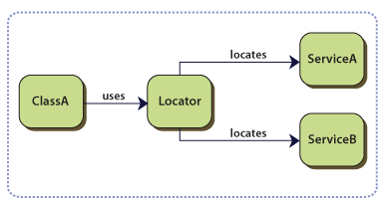
Registry (Service Locator)
☠ Problem: You may know the customer's ID number but not have a reference. In this case you need some kind of lookup method—a finder—but the question remains: How do you get to the finder?
☞ Solution: A Registry is a well-known object that other objects can use to find common objects and services.
Implementation notes:
Singleton pattern
Thread safety
Static methods
Supporting unit tests
Key/value search and caching

Slide 70
C# Example (I)
public class ServiceRegistry
{
public static ServiceRegistry GetInstance()
{
return Nested.SoleInstance;
}
// Lazy initialization with nested class.
// Not being initialzed during class loading.
// https://en.wikipedia.org/wiki/Initialization-on-demand_holder_idiom
private class Nested
{
// Explicit static constructor to tell C# compiler
// not to mark type as beforefieldinit
static Nested() { }
internal static readonly ServiceRegistry SoleInstance = new ServiceRegistry();
}

Slide 71
C# Example (II)
private readonly IDictionary<Type, Type> serviceTypes;
private readonly IDictionary<Type, Object> instantiatedServices;
private ServiceRegistry()
{
this.serviceTypes = new Dictionary<Type, Type>();
this.instantiatedServices = new Dictionary<Type, Object>();
this.Register<IRoleService>(typeof(RoleService));
this.Register<IAgentService>(typeof(AgentService));
}
public void Register<T>(Type resolver)
{
this.serviceTypes[typeof(T)] = resolver;
}

Slide 72
C# Example (III)
public T Resolve<T>()
{
// Lazy initialization improves the performance of object creation,
// deferring long running initializations until they are really needed.
if (this.instantiatedServices.ContainsKey(typeof(T)))
{
return (T)this.instantiatedServices[typeof(T)];
}
else
{

Slide 73
C# Example (IV)
try
{
T service = (T)Activator.CreateInstance(serviceTypes[typeof(T)]);
if (null == service)
{
throw new ApplicationException(String.Format("Cannot create an instance for {0} from {1}", typeof(T), serviceTypes[typeof(T)]));
}
// Add the service to the ones that we have already instantiated
instantiatedServices.Add(typeof(T), service);
return service;
}
catch (KeyNotFoundException)
{
throw new ApplicationException("The requested service is not registered.");
}
}
}
}

Slide 74
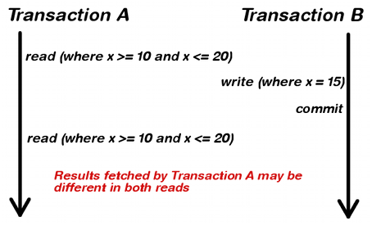
☠ Unit of Work: Problem
You can change the database with each change to your object model, but this can lead to lots of very small database calls, which ends up being very slow.
Furthermore it requires you to have a transaction open for the whole interaction, which is impractical if you have a business transaction that spans multiple requests.
The situation is even worse if you need to keep track of the objects you've read so you can avoid inconsistent reads.

Slide 75
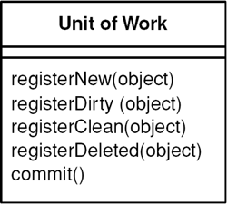
☞ Unit of Work: Solution
Unit of Work is an object that keeps track of new object created and existing ones updated or deleted.
A Unit of Work keeps track of everything you do during a business transaction that can affect the database.
When you're done, it figures out everything that needs to be done to alter the database as a result of your work.

Slide 76
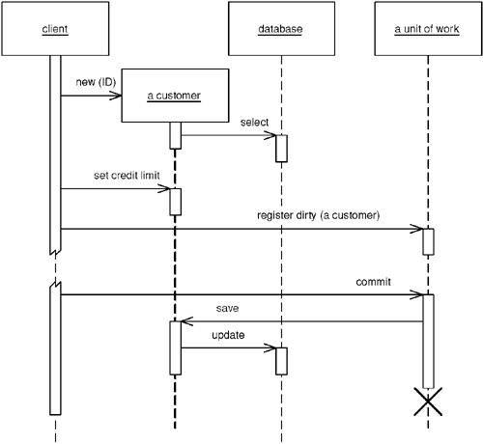
Unit of Work: How It Works?

Slide 77
Unit of Work: Sample Code
class UnitOfWork {
private List newObjects = new ArrayList();
private List dirtyObjects = new ArrayList();
private List removedObjects = new ArrayList();
public void registerNew(Object obj) {
Assert.notNull("id not null", obj.getId());
Assert.isTrue("object not dirty", !dirtyObjects.contains(obj));
Assert.isTrue("object not removed", !removedObjects.contains(obj));
Assert.isTrue("object not already registered new", !newObjects.contains(obj));
newObjects.add(obj);
}
public void commit() {
insertNew();
updateDirty();
deleteRemoved();
}
private void insertNew() {
for (Iterator objects = newObjects.iterator(); objects.hasNext();)
{
DomainObject obj = (DomainObject) objects.next();
RepositoryRegistry.getRepository(obj.getClass()).insert(obj);
}
}
}

Slide 78
Unit of Work Pros and Cons
Perhaps the simplest alternative is to explicitly save any object whenever you alter it.
The problem here is that you may get many more database calls than you want since, if you alter one object at three different points in your work, you get three calls rather than one call in its final state.
To avoid multiple database calls, you can leave all your updates to the end.
➾ To do this you need to keep track of all the objects that have changed.
➾ You can use variables in your code for this, but they soon become unmanageable once you have more than a few.
Unit of Work is a firm platform for more complicated situations, such as handling business transactions that span several system transactions.

Slide 79
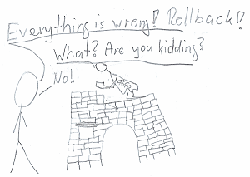
Unit of Work Notes
Use Unit of Work to avoid multiple database calls.
Unit of Work is coupled to data access objects (not business objects).
➾ Keep Unit of Work out of business objects.
Unit of Work often uses transaction features of the selected technology.
➾ In most applications, we just need to use transaction features of the selected technology (see the next examples).

Slide 80
Table Module Transaction Example
Create table Booking (passport number, room number, from date, to date, price)
Create BookingModule class
Create Book(passportNumber, roomNumber, fromDate, toDate, price) method.
Check passport number rule.
Create RoomModule class and use it to get available room from the table Rooms (using ReservedUntil field).
Get returned customer from the table Booking (using PassportNumber field).
Calculate price.
Insert information (passport number, room number, from date, to date, price) into the table Booking and log the action to a flat file.
Update ReservedUntil field of the table Rooms and log the action to a flat file.
BookingGateway
RoomGateway
Start a transaction here.

Slide 81
BO Transaction Example
BookingGateway
Create table Booking (passport number, room number, from date, to date, price)
Create Customer class with PassportNumber property and use it to check passport number rule and get returned customer.
Create Room class with RoomNumber and ReservedUntil property and use it to get available room.
Create BookingPrice class with StartDate, EndDate and Customer properties and GetPrice method
Create BookingDTO class with the following properties: PassportNumber, FromDate, ToDate, RoomNumber, Price.
Create Booking class with Customer, Room and BookingPrice properties.
Create BookingDTO Book(BookingDTO input) method.
Create Customer, Room and BookingPrice instance and call appropriate methods.
Insert information (passport number, room number, from date, to date, price) into the table Booking and log the action to a flat file (Booking’s responsibility).
Update ReservedUntil field of the table Rooms and log the action to a flat file (Room’s responsibility).
RoomGateway

Slide 83
How to Process a Request? [4]
Protocol handling and context transformation
Handling a protocol-specific request, transfer of protocol-specific state into a more general form.
Navigation and routing
Choosing the routing for handling a particular request, such as what objects will perform the core processing for this request, and what view will be used to display the results.
Core processing
The actual servicing of the request.
Dispatch
Transferring control from one part of the application to another, such as from the request-handling mechanism to the view-processing components.

Slide 84
☠ Intercepting Filter: Problem
You want to intercept and manipulate a request and a response before and after the request is processed.
Preprocessing and post-processing of a request refer to actions taken before and after the core processing of that request.
Does the client have a valid session?
Does the request path violate any constraints?
Do you support the browser type of the client?
What encoding does the client use to send the data?
Is the request stream encrypted or compressed?

Slide 85
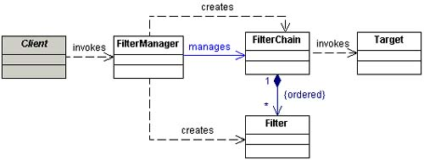
☞ Intercepting Filter: Solution
Use an Intercepting Filter as a pluggable filter to pre and post-process requests and responses.
A filter manager combines loosely coupled filters in a chain, delegating control to the appropriate filter.
In this way, you can add, remove, and combine these filters in various ways without changing existing code.

Slide 86
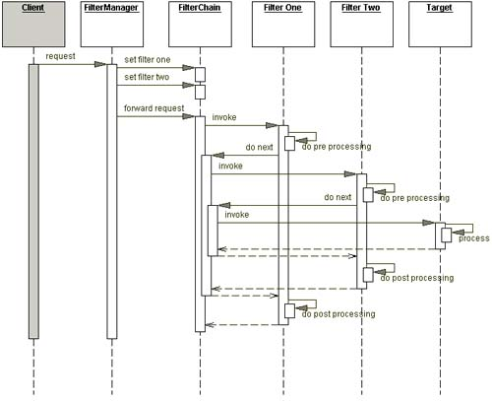
Intercepting Filter: Dynamic Structure

Slide 87
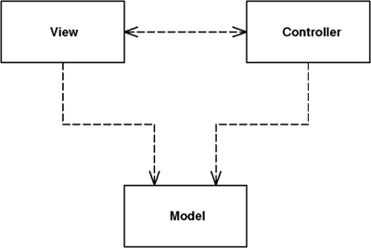
Model View Controller [3]
☠ Problem:
Presentation modification affects the whole application?
Adding additional presentations affects the whole application?
☞ Solution: Model-View-Controller (MVC) considers three roles.
The model is an object that represents some information about the domain.
The view represents the display of the model in the UI.
The controller takes user input, manipulates the model, and causes the view to update appropriately.
In this way UI is a combination of the view and the controller.
The value of MVC lies in its two separations.
Separation of presentation from model
Separation of view and controller

Slide 88
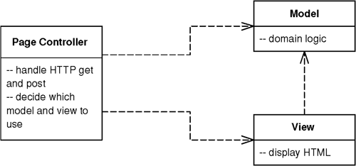
Page Controller
☠ Problem: How do we design each page on the Web site?
☞ Solution: Page Controller is an object that handles a request for a specific page or action on a Web site.
The basic responsibilities of a Page Controller are:
Decode the URL and extract any form data to figure out all the data for the action.
Create and invoke any model objects to process the data. All relevant data from the HTML request should be passed to the model so that the model objects don't need any connection to the HTML request.
Determine which view should display the result page and forward the model information to it.

Slide 89
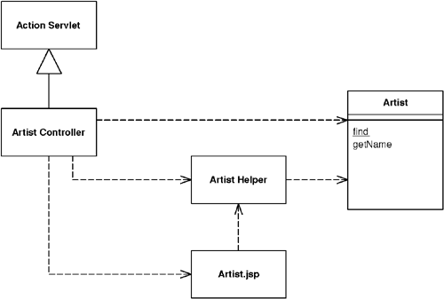
When to Use Page Controller?
Page Controller works particularly well in a site where most of the controller logic is pretty simple.
In this case most URLs can be handled with a server page and the more complicated cases with helpers.

Slide 90
☠ Front Controller: Problem [3, 4]
You want a centralized access point for presentation-tier request handling.
You want to avoid duplicate control logic.
You want to apply common logic to multiple requests.
You want to separate system processing logic from the view.
You want to centralize controlled access points into your system.

Slide 91
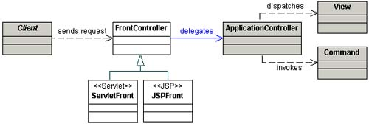
☞ Front Controller: Solution
Use a Front Controller as the initial point of contact for handling all related requests.
The Front Controller centralizes control logic that might otherwise be duplicated, and manages the key request handling activities.

Slide 92
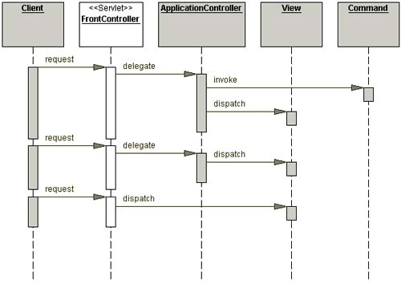
Front Controller: Dynamic Structure

Slide 93
How to Use Front Controller?
Only one Front Controller has to be configured into the Web server; the Web handler does the rest of the dispatching.
There's just one controller, so you can easily enhance its behavior at runtime with decorators.
You can have decorators for authentication, character encoding, internationalization, and so forth, and add them using a configuration file or even while the server is running.

Slide 95
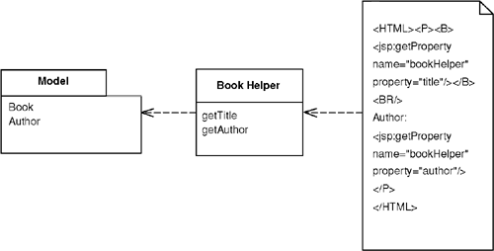
Template View [3]
☠ Problem: Creating and concatenating string constructs is still painful.
☞ Solution: Use template view to compose the dynamic Web page as you do a static page but put in markers that can be resolved into calls to gather dynamic information.
Template view is view helper in [4].

Slide 96
When to Use Template View?
The strength of Template View is that it allows you to compose the content of the page by looking at the page structure.
Template View has two significant weaknesses.
The common implementations make it too easy to put complicated logic in the page, thus making it hard to maintain, particularly by nonprogrammers.
Template View is harder to test.

Slide 97
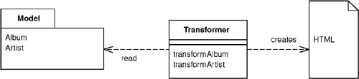
Transform View
☠ Problem: Creating and concatenating string constructs is still painful.
☞ Solution: The basic notion of Transform View is writing a program that looks at domain-oriented data and converts it to HTML.
The program walks the structure of the domain data and, as it recognizes each form of domain data, it writes out the particular piece of HTML for it.

Slide 98
When to Use Transform View?
It's easier to keep the transform focused only on rendering HTML, thus avoiding having too much other logic in the view.
It's also easy to run the Transform View and capture the output for testing.
Tools for XSLT are, at least so far, much less sophisticated.
Also, XSLT can be an awkward language to master because of its functional programming style coupled with its awkward XML syntax.

Slide 99
Composite View [4]
Developing and maintaining dynamic views is challenging, since there are often aspects of both the view content and the view layout that are common across multiple views.
When content and layout are intertwined, it is harder to maintain and extend the views.
Reuse and modularity also suffer when common code is duplicated across views.
☠ Problem: You want to build a view from modular, atomic component parts that are combined to create a composite whole, while managing the content and the layout independently.

Slide 100
Composite View: Forces
You want common sub-views, such as headers, footers and tables reused in multiple views, which may appear in different locations within each page layout.
You have content in sub-views which might which frequently change or might be subject to certain access controls, such as limiting access to users in certain roles.
You want to avoid directly embedding and duplicating sub-views in multiple views which makes layout changes difficult to manage and maintain.

Slide 101
☞ Composite View: Solution
Use Composite Views that are composed of multiple atomic sub-views.
Each sub-view of the overall template can be included dynamically in the whole, and the layout of the page can be managed independently of the content.
Composite Views are based on the inclusion and substitution of modular dynamic and static template fragments.
Composite Views promote the reuse of atomic portions of the view by encouraging modular design.

Slide 102
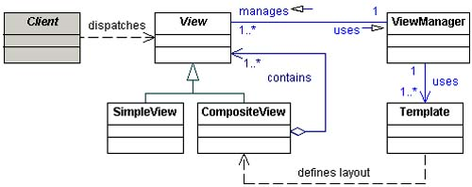
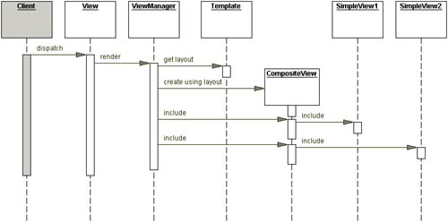
Composite View: Structure

Slide 104
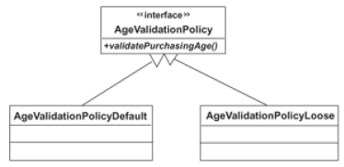
Simple Policy [5]
☠ Problem:
How to dynamically set and enforce access policies for our application?
☞ Solution:
The Simple Policy pattern is similar to the GOF's Strategy design pattern, but specialized to deal with the realities of business.
The Simple Policy pattern allows us to dynamically set and enforce access policies for our application.

Slide 105
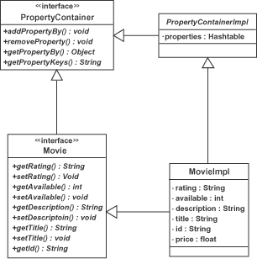
Property Container
☠ Problem:
How to customize class properties at runtime?
☞ Solution:
A Property Container is a class whose properties can be customized at runtime without having to edit your class definition.
Its function is to ensure that an application, once built and deployed, can be dynamically extended.

Slide 106

Thank You & See You Again

